Slide 1

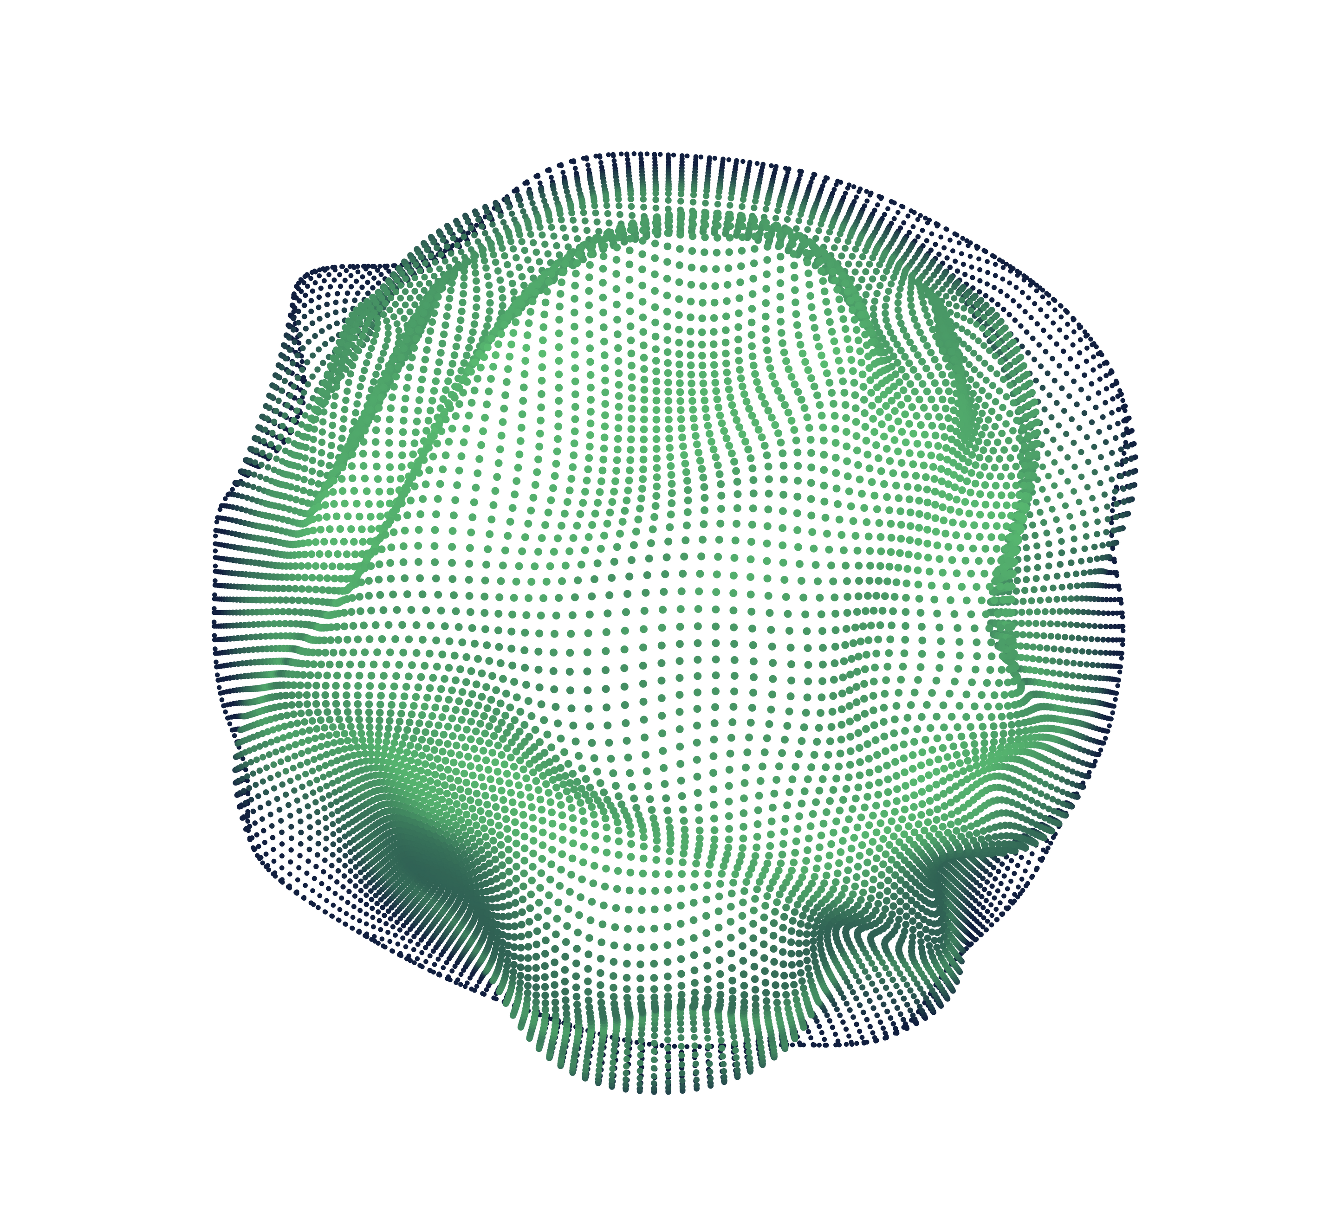


Long
Short-Term
Memory Network: A Review
Nicolae Mogage – ICA

Slide 2
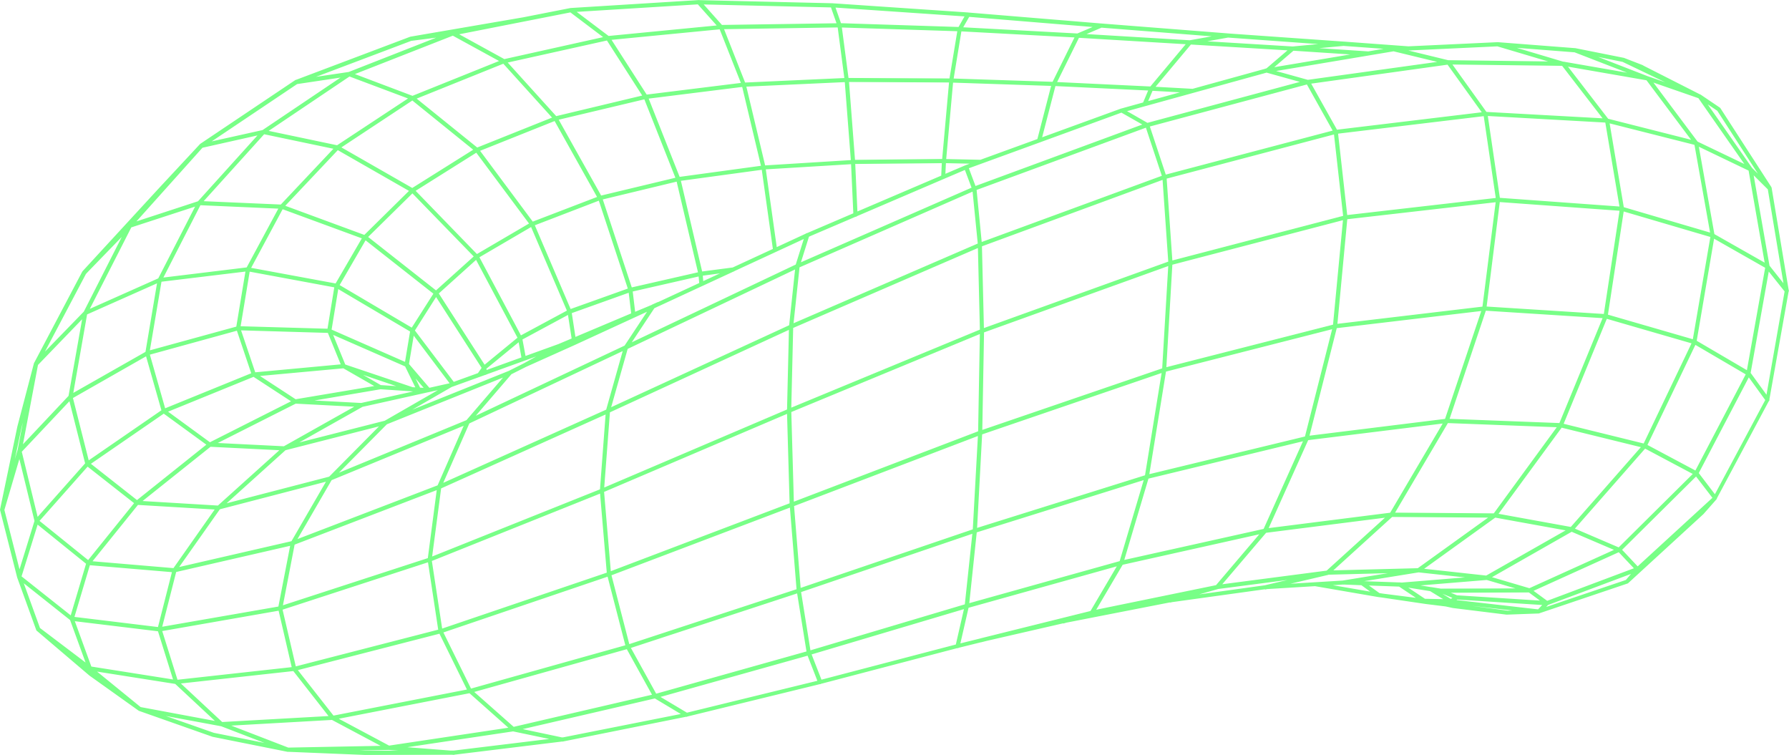
CONTENT
O
O
1
LONG SHORT-TERM MEMORY
2
DATASETS
O
O
3
EXPERIMENTS
4
CONCLUSIONS

Slide 3

↖ ↗
↘ ↙
1
Long short-term memory

Slide 4

Feedforward vs Recurrent networks

Slide 5
RNN vs LSTM
RNN
LSTM

Slide 6
↖ ↗
↘ ↙
2
Datasets

Slide 7
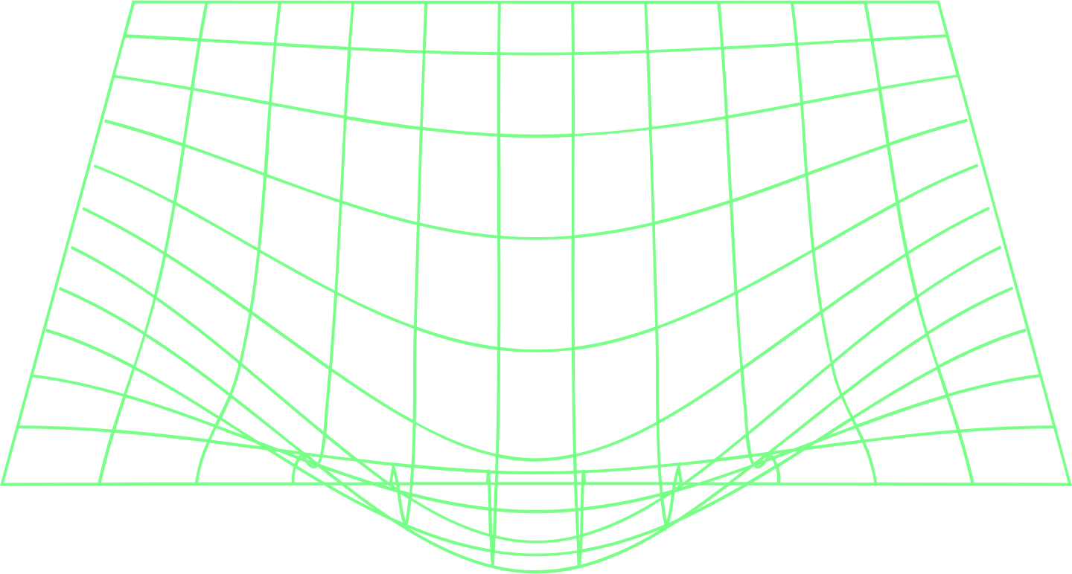
Specifics
Classification
Sentiment140
UrbanSound8K
Regression
Jena Climate
Top 100 Cryptocurrencies

Slide 8
↖ ↗
↘ ↙
3
Experiments

Slide 9

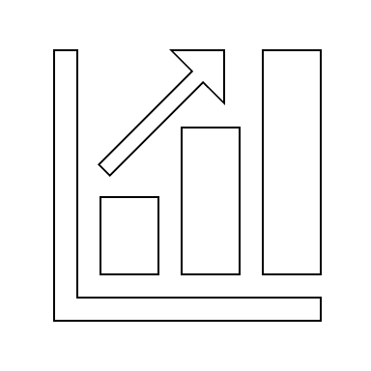

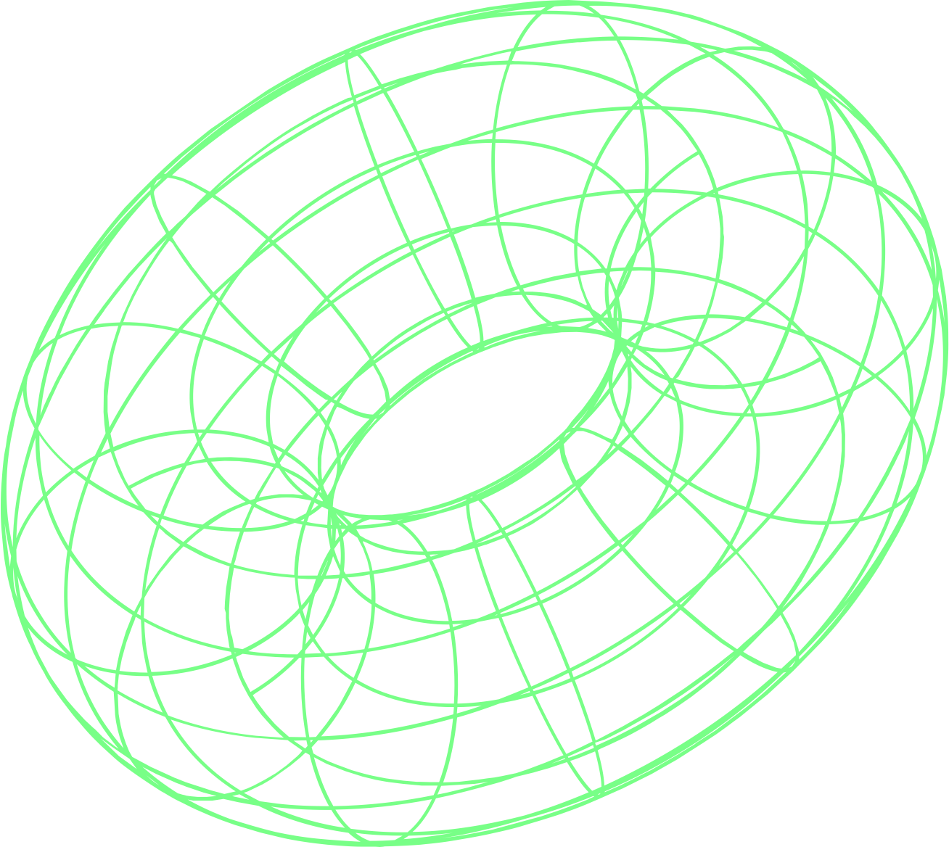
Setup
Model
Functions
Metrics

Slide 10
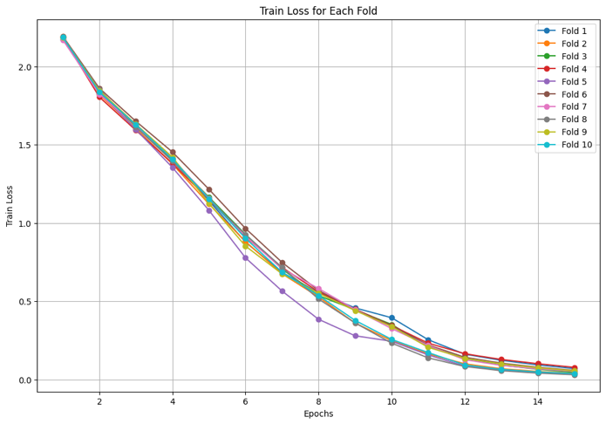
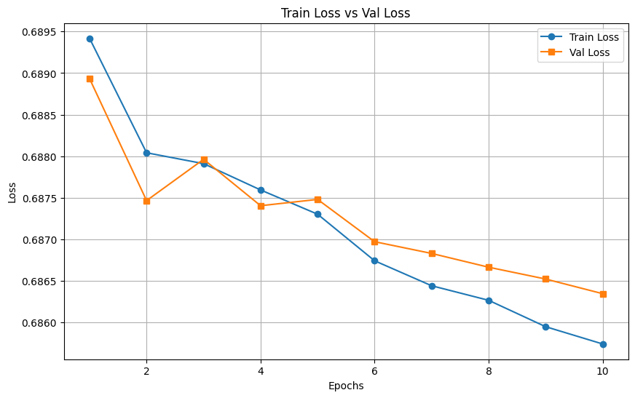
Losses
Sentiment140
UrbanSound8k

Slide 11
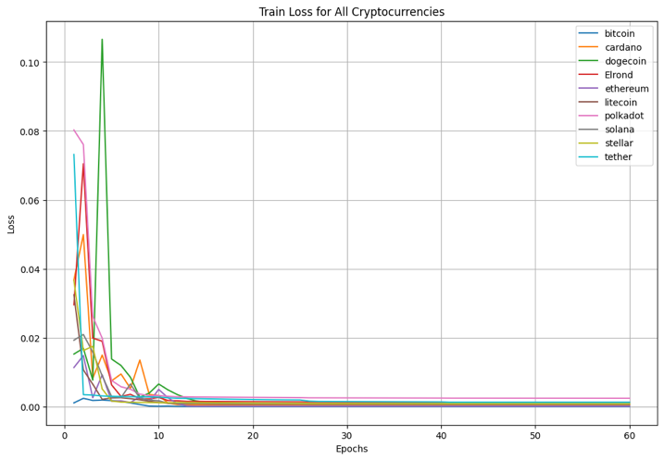
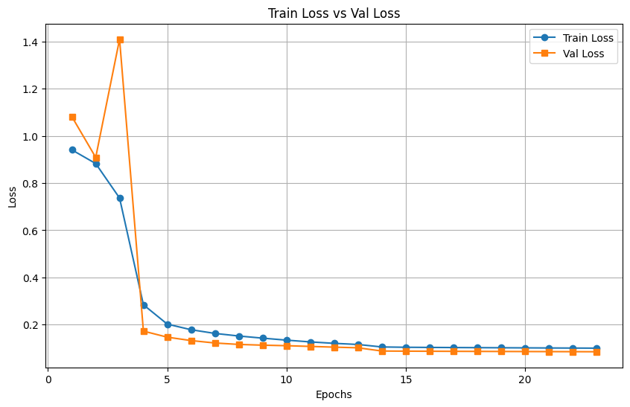
Losses
Jena Climate
Top 100 Crypto

Slide 12

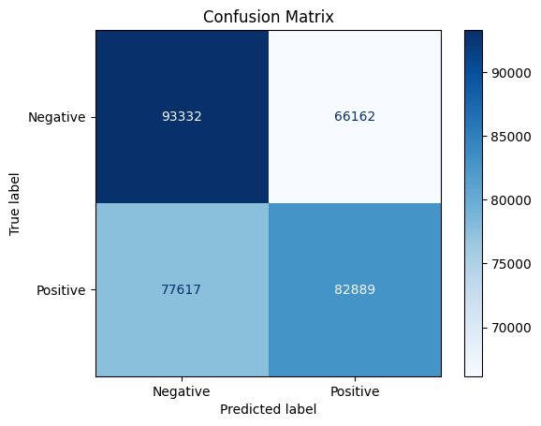
Results – Sentiment140

Slide 13
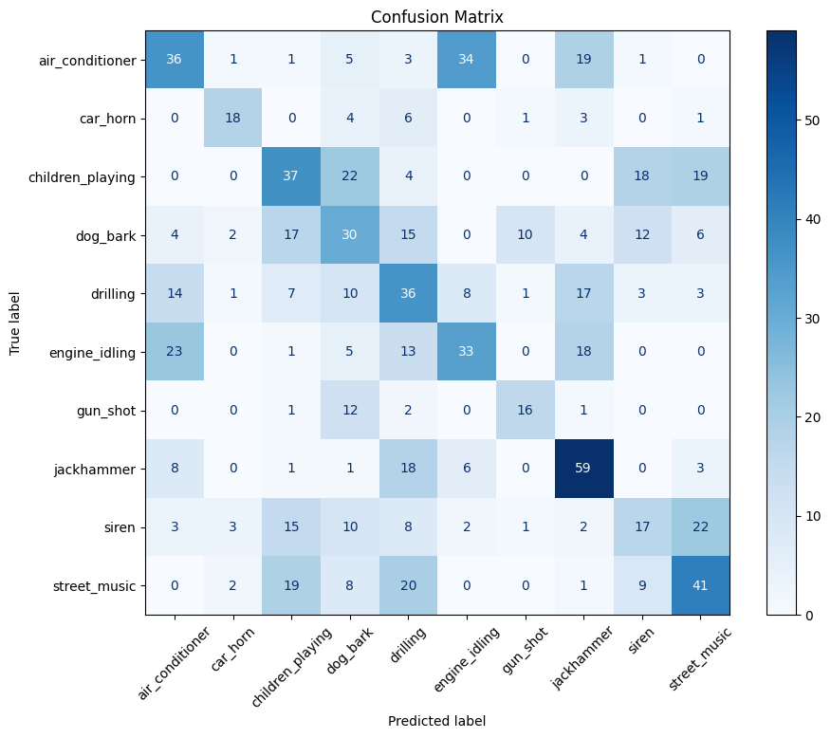
Results – UrbanSound8k

Slide 14
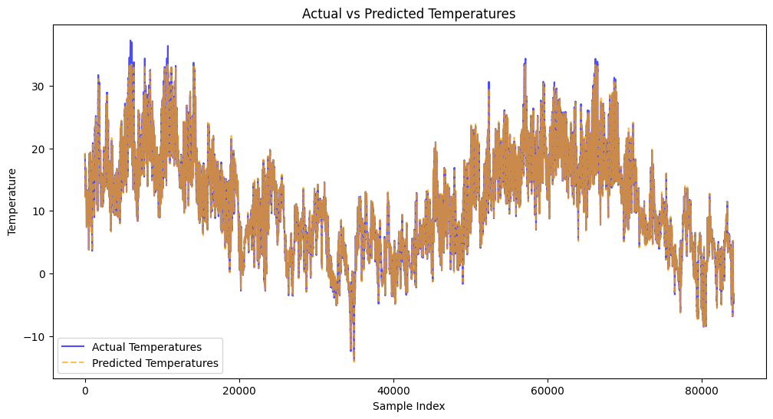
Results – Jena Climate

Slide 15
Results – Top 100 Crypto

Slide 16
Results – Top 100 Crypto

Slide 17
↖ ↗
↘ ↙
4
Conclusions

Slide 18

THANK YOU!

